Slide 1
EagleSat 2: Design Development Lauren Barthenheier Dr. Gary Yale, Embry-Riddle Aeronautical University Arizona Space Grant Consortium Symposium April 22, 2017

Slide 2
Outline
Background
Initial Design
Design Change
Current Design
Conclusion

Slide 3
Background
Goals:
Submit proposal to CSLI (CubeSat Launch Initiative) in November of 2017
Focus on commercially available bus systems (EPS, COMMS, ACS, OBC) to allow better payload development

Slide 4
Initial Design Requirements
Fly three payloads
Survey space debris and space dust
Charged particle detector
Pointing requirement: Must face away from earth
Memory degradation experiment
Data Collection
Space debris: 96 Mb per orbit
Charged particle detector: 8 Mb per orbit
Memory degradation experiment: 2.25 Mb per orbit

Slide 5
Data Margins
Base: 17.6 W
Max Expected: 18.46 w
Max Possible: 19 W
Max
Possible
Max
Expected
Base

Slide 6
Power Margins
Base: 107 Mb
Max Expected: 123 Mb
Max Possible: 130 Mb

Slide 7
Decision Process
Denial
Anger
Bargaining
Depression
Acceptance
Pay
Want
Tech

Slide 8
Cut Primary Payload
Stability requirements imposed on ADACS by Primary payload were too tight
Margins too tight for data and power
High cost

Slide 9
Current Design

Slide 10
Current Design Requirements
Fly two payloads
Charged particle detector
Pointing requirement: Must face away from earth
Memory degradation experiment
Data Collection
Charged particle detector: 40 Mb per orbit
Memory degradation experiment: 2 Mb per orbit

Slide 11
Expanding Payloads
Charged particle detector
CMOS imaging sensor
Additional information from a second axis
Memory degradation
D-Type Flip Flops
Determine if the circuit is corrupted due to space radiation
Radiation Hardened Chips
Baseline for data

Slide 12
Power Margins
Base: 15 W
Max Expected: 16 W
Max Possible: 19 W

Slide 13
Data Margins
Base: 11.25 Mb
Max Expected: 12.9 Mb
Max Possible: 25 Mb

Slide 14
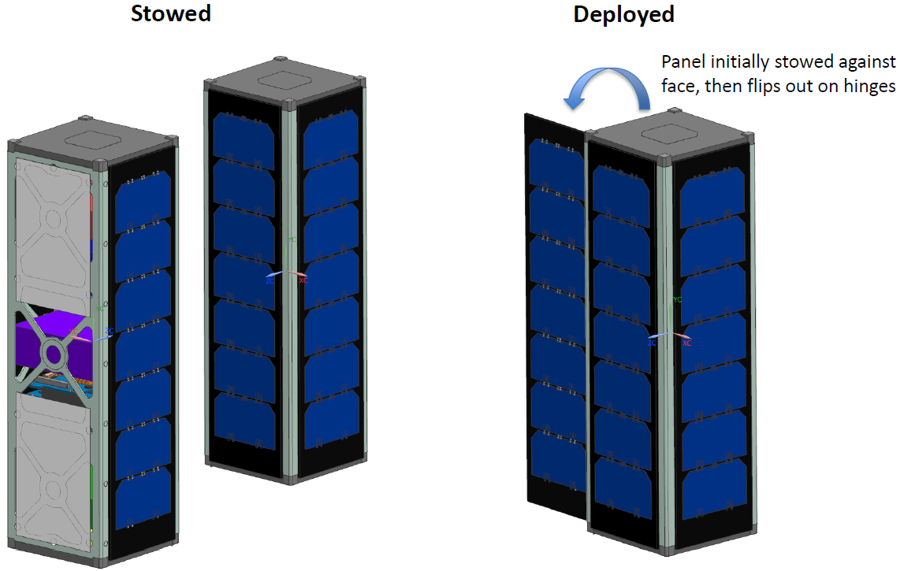
Solar Panel Design
Three 3U solar panels fulfill power requirements
One solar panel needs to be deployed so all three can see the sun at the same time

Slide 15
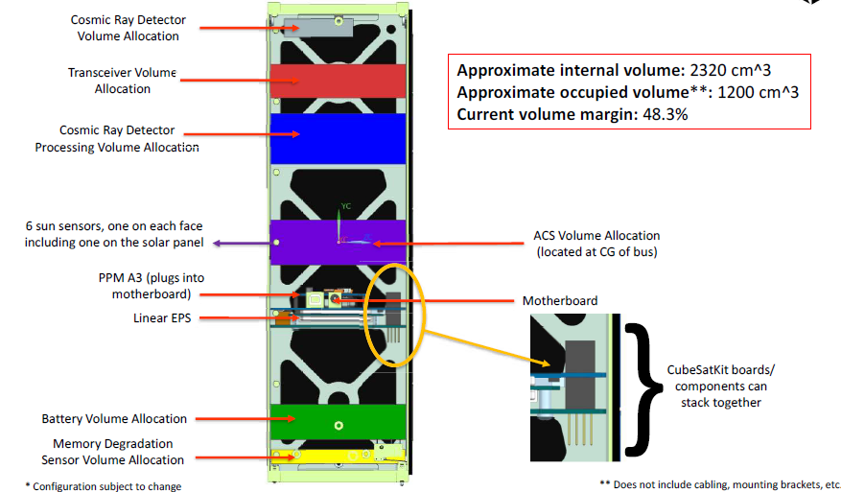
Internal Configuration
Internal volume: 2,320 cm³
Occupied volume: 1,200 cm³
Volume margin: 48.3%

Slide 16
Conclusion
Cut primary payload
Reduced costs and data requirements
Expanded charged particle detector and memory degradation experiment
Deployable solar panel to meet power requirements

Slide 17
Acknowledgements
Dr. Gary Yale, Embry-Riddle Aeronautical University
TeamXC, NASA Jet Propulsion Laboratory
Travis Imken, NASA Jest Propulsion Laboratory

Slide 18
Thank You

